Slide 1
Network Communications and Protocols
Chapter 6

Slide 2
Learning Objectives
Understand function and structure of packets in network, and analyze and understand these packets
Understand function of protocols in network
Discuss layered architecture of protocols, and describe common protocols and their implementation
Understand channel access methods

Slide 3
Function of Packets in Network Communications
Networks reformat data into smaller, more manageable pieces called packets or frames
Advantages of splitting data include:
More efficient transmission, since large units of data saturate network, as seen in Figure 6-1
More computers able to use network
Faster transmissions since only packets containing errors need to be retransmitted

Slide 4
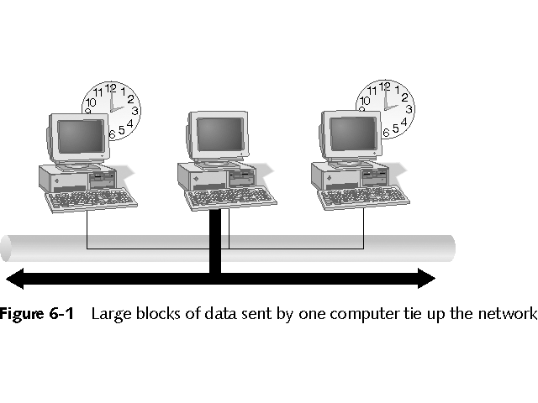
Large Blocks of Data Sent by One Computer Tie Up Network

Slide 5
Packet Structure
Three basic parts of packet, as seen in Figure 6-2:
Header – contains source and destination address along with clocking information to synchronize transmission
Data –payload or actual data, can vary from 512 bytes to 16 kilobytes
Trailer – information to verify packet’s contents, such as Cyclic Redundancy Check (CRC)

Slide 6
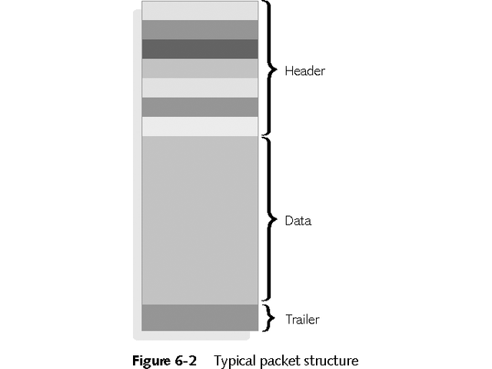
Typical Packet Structure

Slide 7
Packet Creation
From sender, data moves down layers of OSI model
Each layer adds header or trailer information
Data travels up layers at receiver
Each layer removes header or trailer information placed by corresponding sender layer
See Figure 6-3

Slide 8
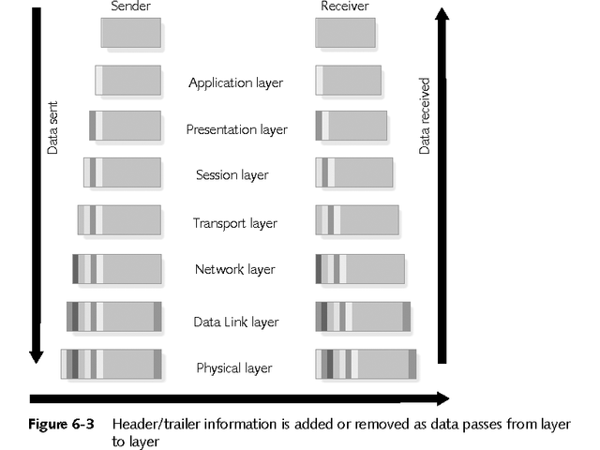
Header/Trailer Information Added or Removed

Slide 9
Packet Creation
Outgoing data stream enters OSI model as complete message
Remains as data at Layers 5-7
Lower-layers split data
Transport Layer 4 splits it into segments
Network Layer 3 splits segments into packets
Data Link Layer 2 puts packets into frames
Physical Layer 1 transmits packets as bits

Slide 10
Understanding Packets
Three kinds of packets:
Unicast packet - addressed to only one computer
Broadcast packet – created for all computers on network
Multicast packet – created for any computers on network that “listen” to shared network address

Slide 11
Protocols
Rules and procedures for communicating
To communicate, computers must agree on protocols
Many kinds of protocols:
Connectionless
Connection-oriented
Routable
Nonroutable

Slide 12
The Function of Protocols
Each protocol has different purpose and function
Protocols may work at one or more layers
More sophisticated protocols operate at higher layers of OSI model
Protocol stack or protocol suite is set of protocols that work cooperatively
Most common protocol stacks are TCP/IP used by the Internet and IPX/SPX used by Novell NetWare

Slide 13
Connectionless Versus Connection-Oriented Protocols
Two methods for delivering data across network:
Connectionless – no verification that datagrams were delivered; fast protocols with little overhead
Connection-oriented – more reliable and slower protocols that include verification that data was delivered; packets resent if errors occur

Slide 14
Routable Versus Nonroutable Protocols
Network Layer 3 moves data across multiple networks using routers
Routable – protocols that function at Network layer, such as TCP/IP or IPX/SPX, essential for large-scale networks or enterprise networks
Nonroutable – protocols that do not include Network layer routing capabilities, such as NetBEUI, work well in small network
Consider current size and future expansion possibilities when choosing protocol suite

Slide 15
Protocols in a Layered Architecture
Most protocols can be positioned and explained in terms of layers of OSI model
Protocol stacks may have different protocols for each player
See Figure 6-4 for review of functions of each layer of OSI model
See Figure 6-5 for three major protocol types
Application protocols at Layers 5-7
Transport protocols at Layer 4
Network protocols at Layers 1-3

Slide 16
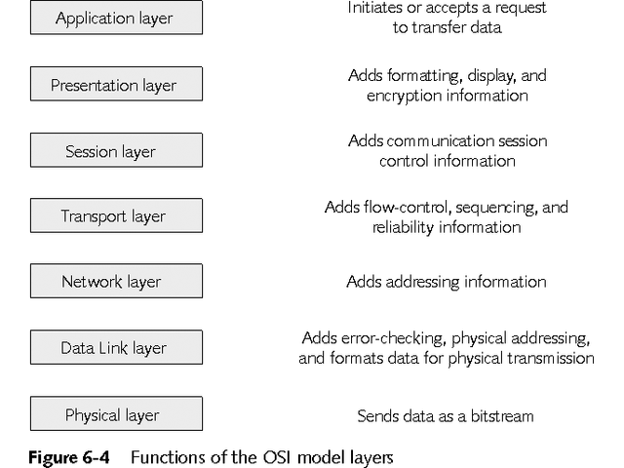
Functions of OSI Model Layers

Slide 17
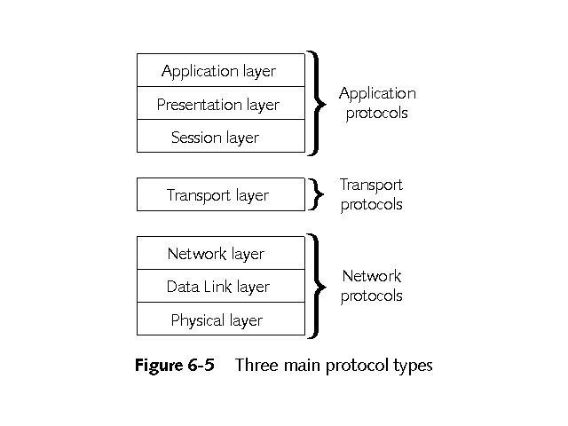
Three Main Protocol Types

Slide 18
Network Protocols
Provide addressing and routing information, error checking, and retransmission requests
Services provided by network protocols are called link services
Popular network protocols include:
Internet Protocol (IP)
Internetwork Packet Exchange (IPX) and NWLink
NetBEUI
Delivery Datagram Protocol (DDP)
Data Link Control (DLC)

Slide 19
Transport Protocols
Handle data delivery between computers
May be connectionless or connection-oriented
Transport protocols include:
Transmission Control Protocol (TCP)
Sequenced Packet Exchange (SPX) and NWLink
AppleTalk Transaction Protocol (ATP) and Name Binding Protocol (NBP)
NetBIOS/NetBEUI

Slide 20
Application Protocols
Operate at upper layers of OSI model to provide application-to-application service
Some common application protocols are:
Simple Mail Transport Protocol (SMTP)
File Transfer Protocol (FTP)
Simple Network Management Protocol (SNMP)
NetWare Core Protocol (NCP)
AppleTalk File Protocol (AFP)

Slide 21
Common Protocol Suites
Combination of protocols that work cooperatively to accomplish network communications
Some of the most common protocol suites are:
DLC
XNS
DECNet
X.25
TCP/IP
NWLink (IPX/SPX)
NetBIOS/NetBEUI
AppleTalk

Slide 22
Transmission Control Protocol/ Internet Protocol (TCP/IP
Called the Internet Protocol (IP)
Most commonly used protocol suite for networking
TP/IP used by US Department of Defense’s Advanced Research Projects Agency (ARPA)
Excellent scalability and superior functionality
Able to connect different types of computers and networks
Default protocol for Novell NetWare, Windows 2000/XP, and Windows NT
See Figure 6-6 for relationship to OSI model

Slide 23
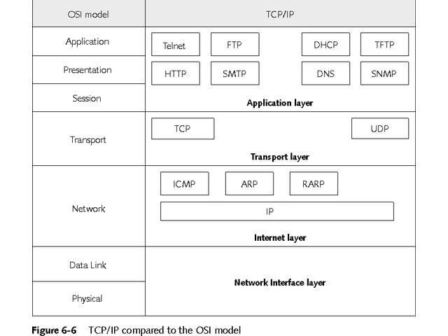
TCP/IP Compared to OSI Model

Slide 24
TCP/IP
Includes highly compartmentalized and specialized protocols, including:
Internet Protocol (IP) – Connectionless Network layer protocol that provides source and destination routing; fast, but unreliable
Internet Control Message Protocol (ICMP) – Network layer protocol that sends control messages; PING uses ICMP
Address Resolution Protocol (ARP) – Network layer protocol that associates logical (IP) address to physical (MAC) address

Slide 25
More TCP/IP Protocols
Transmission Control Protocol (TCP) – primary Internet transport protocol; connection-oriented; provides reliable delivery; fragments and reassembles messages
User Datagram Protocol (UDP) - connectionless Transport layer protocol; fast, unreliable
Domain Name System (DNS) – Session layer name-to-address resolution protocol
File Transfer Protocol (FTP) – performs file transfer, works at Session, Presentation, and Application layers

Slide 26
More TCP/IP Protocols
Telnet – remote terminal emulation protocol; operates at three upper layers; provides connectivity through dissimilar systems
Simple Mail Transport Protocol (SMTP) – operates at three upper layers to provide messaging; allows e-mail to travel on Internet
Routing Information Protocol (RIP) – Network layer distance-vector protocol used for routing; not suitable for large networks
Open Shortest Path First (OSPF) – link-state routing protocol; uses variety of factors to determine best path

Slide 27
IP Addressing
Logical addresses, 32-bits or 4 bytes long
Four octets separated by periods, each with decimal value from 0-255
First part of address identifies network
Second part of address identifies host or individual computer
IP addresses broken into classes
Number of IP address registries under control of Internet Assigned Numbers Authority (IANA)

Slide 28
IP Address Classes
Three classes of IP addresses for normal networking:
Class A – addresses between 1-126; first octet identifies network and last three identify host; over 16 million hosts per network
Class B – addresses between 128-191; first two octets identify network and last two identify host; over 65,000 hosts per network
Class C – addresses between 192-223; first three octets identify network and last one identifies host; limited to 254 hosts per network

Slide 29
IP Address Classes
Two classes of IP addresses have special purposes:
Class D – addresses range from 224-239; reserved for multicasting; used for videoconferencing and streaming media
Class E – addresses range from 240-255; reserved for experimental use

Slide 30
Special Service IP Addresses
Some addresses used for special services:
IP addresses beginning with 127 are loopback addresses; also called localhost
Reserved addresses for private networks include:
Class A addresses beginning with 10
Class B addresses from 172.16 to 172.31
Class C addresses from 192.168.0 to 192.168.255

Slide 31
IPv6
Current four byte version is IPv4
Now reaching limit of 4-byte addresses
IETF working on new implementation of TCP/IP, designated IPv6
Uses 16 byte addresses
Retains backward compatibility with IPv4 4-byte addresses
Will provide limitless supply of addresses

Slide 32
Classless Inter-Domain Routing (CIDR)
Internet uses CIDR
Demarcation between network and host not always based on octet boundaries
May be based on specific number of bits from beginning of address
Called subnetting, the process involves “stealing” bits from host portion of address for use in network address
Provides fewer hosts on each networks but more networks overall

Slide 33
Subnet Masks
Part of IP address identifies network and part identifies host
IP uses subnet mask to determine what part of address identifies network and what part identifies host
Network section identified by binary 1
Host section identified by binary 0

Slide 34
Subnet Masks
Each class of addresses has default subnet mask
Class A default subnet mask is 255.0.0.0
Class B default subnet mask is 255.255.0.0
Class C default subnet mask is 255.255.255.0
All devices on single physical network or network segment must share same network address and use same subnet mask

Slide 35
Some Simple Binary Arithmetic
Four kinds of binary calculations:
Converting between binary and decimal
Converting between decimal and binary
Understanding how setting high-order bits to value of 1 in 8-bit binary numbers corresponds to specific decimal numbers
Recognizing decimal values for numbers that correspond to low-order bits when they’re set to value of 1
Keep in mind that any number raised to zero power equals one

Slide 36
Converting and Understanding High- and Low- Bit Patterns
Converting Decimal to Binary
Divide number by 2 and write down remainder which must be 1 or 0
Converting Binary to Decimal
Use exponential notation
High-Order Bit Patterns
See Table 6-1
Low-Order Bit Patterns
See Table 6-2

Slide 37
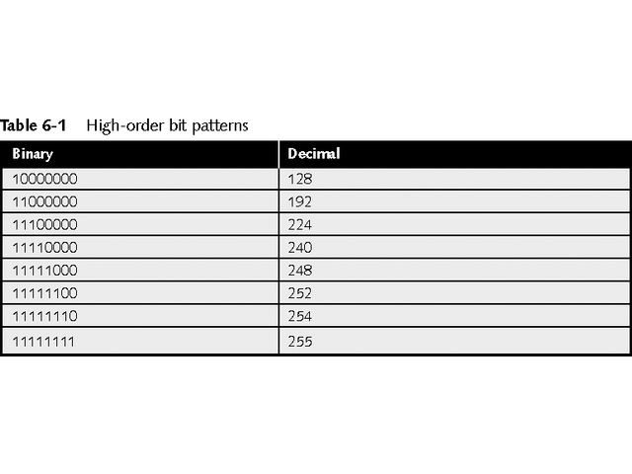
High-Order Bit Patterns

Slide 38
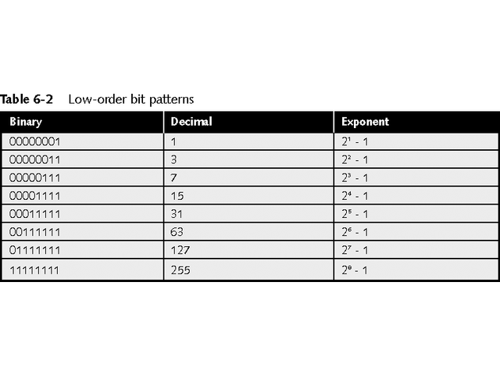
Low-Order Bit Patterns

Slide 39
Calculating a Subnet Mask
Follow these steps to build subnet mask:
Decide how many subnets you need
Add two to number of subnets needed (one for network address and other for broadcast address). Then jump to next highest power of 2
Reserve bits from top of host portion of address down
Be sure enough host addresses to be usable are left over
Use formula 2^{b} – 2 to calculate number of usable subnets, where b is number of bits in subnet mask

Slide 40
Calculating Supernets
Supernetting “steals” bits from network portion of IP address
Supernets permit multiple IP network addresses to be combined and function as a single logical network
Permit more hosts to be assigned on supernet
Improves network access efficiency

Slide 41
Network Address Translation (NAT)
Allows organization to use private IP addresses while connected to the Internet
Performed by network device such as router that connects to Internet
See Figure 6-7 for example of NAT

Slide 42
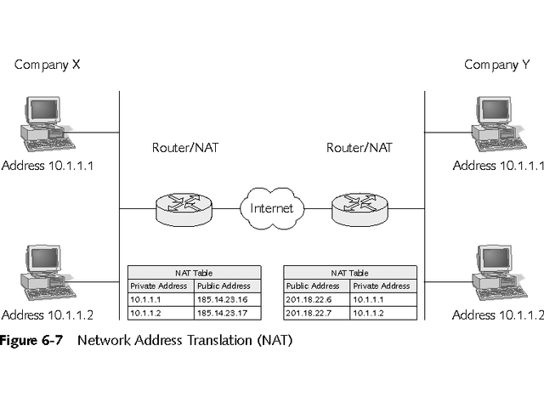
Network Address Translation (NAT)

Slide 43
Dynamic Host Configuration Protocol (DHCP)
DHCP server receives block of available IP addresses and their subnet masks
When computer needs address, DHCP server selects one from pool of available addresses
Address is “leased” to computer for designated length and may be renewed
Can move computers with ease; no need to reconfigure IP addresses
Some systems, such as Web servers, must have static IP address

Slide 44
NetBIOS and NetBEUI
Consortium of Microsoft, 3Com, and IBM developed lower-level protocol NetBEUI in mid-1980s
NetBIOS Extended User Interface
Spans Layers 2, 3, and 4 of OSI model
Both designed for small- to medium-sized networks, from 2-250 computers

Slide 45
NetBIOS and NetBEUI
Figure 6-8 shows Microsoft protocol suite and its relationship to OSI model
Defines four components above Data Link layer
Runs on any network card or physical medium
Redirector interprets requests and determines whether they are local or remote
If remote, passes request to Server Message Block (SMB)
SMB passes information between networked computers

Slide 46
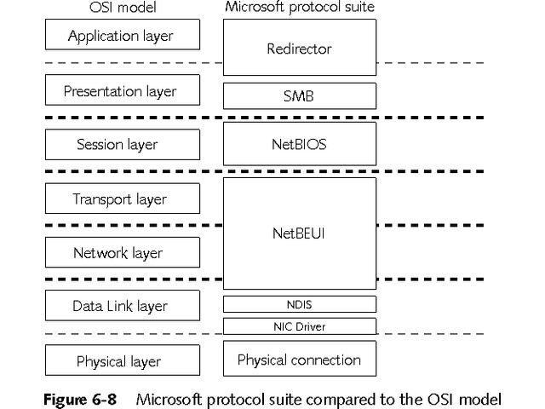
Microsoft Protocol Suite Compared to OSI Model

Slide 47
NetBIOS and NetBEUI
NetBEUI works at Transport layer to manage communications between two computers
Nonroutable protocol; skips Network layer
NetBEUI packet does not contain source or destination network information

Slide 48
NetBIOS and NetBEUI
NetBIOS operates at Session layer to provide peer-to-peer network application support
Unique 15-character name identifies each computer in NetBIOS network
NetBIOS broadcast advertises computer’s name
Connection-oriented protocol, but can also use connectionless communications
Nonroutable protocol, but can be routed when using routable protocol for transport

Slide 49
NetBIOS and NetBEUI
NetBEUI is small, fast, nonroutable Transport and Data Link protocol
All Windows versions include it
Ideal for DOS based computers
Good for slow serial links
Limited to small networks
Server Message Block operates at Presentation layer
Used to communicate between redirector and server software

Slide 50
IPX/SPX
Original protocol suite designed for Novell’s NetWare network operating system
Still supported with NetWare 6.0, but TCP/IP is now primary protocol
NWLink is Microsoft’s implementation of IPX/SPX protocol suite
Figure 6-9 shows protocols in NWLink and corresponding OSI layers
Must consider which Ethernet frame type with NWLink

Slide 51
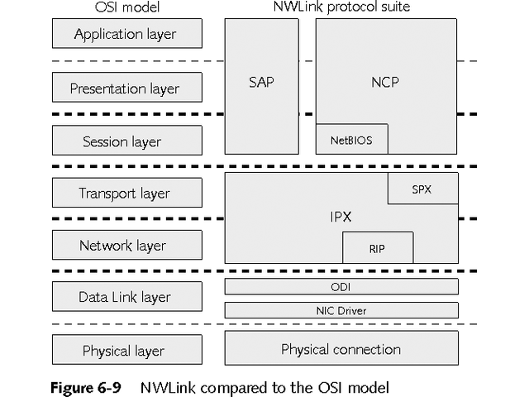
NWLink Compared to OSI Model

Slide 52
IPX/SPX
Open Data-link Interface (ODI) lets single network driver support multiple protocols through single NIC
Internetwork Packet Exchange (IPX) is Transport and Network layer protocol
Handles addressing and routing
Connectionless protocol
Provides fast, but unreliable, services

Slide 53
IPX/SPX
Other protocols in the IPX/SPX suite include:
IPX Routing Information Protocol (IPX RIP) – distance-vector protocol; uses ticks to determine best path; exchanges information about network addresses and topology
Sequenced Packet Exchange (SPX) – provides connection-oriented service; more reliable
NetWare Core Protocol (NCP) – works at Transport and upper layers to provide range of client-server functions

Slide 54
IPX/SPX
Other protocols in IPX/SPX suite include:
Service Advertising Protocol (SAP) – used by file and print servers to advertise services
Service Lookup Protocol (SLP) – new IP-based NetWare protocol used with Novell Directory Services; used when clients want to look up services on IP-only network

Slide 55
AppleTalk
Defines physical transport in Apple Macintosh networks
Divides computers in zones
AppleTalk Phase II allows connectivity outside Macintosh world

Slide 56
Xerox Network Systems (XNS)
Designed for Ethernet networks
Basis for Novell’s IPX/SPX
Rarely used in today’s networks

Slide 57
DECNet
Used with Digital Network Architecture
Proprietary protocol
Complete routable suite
Phase IV closely resembles OSI model

Slide 58
X.25
Set of wide-area protocols
Designed to connect remote terminals to mainframes
Used in packet-switching networks
Still widely used in Europe

Slide 59
Implementing and Removing Protocols
Easy to add or remove protocols
TCP/IP loads automatically when most operating systems are installed
In Windows 2000/XP, use Network and Dial-up Connections control panel
See Figure 6-10

Slide 60
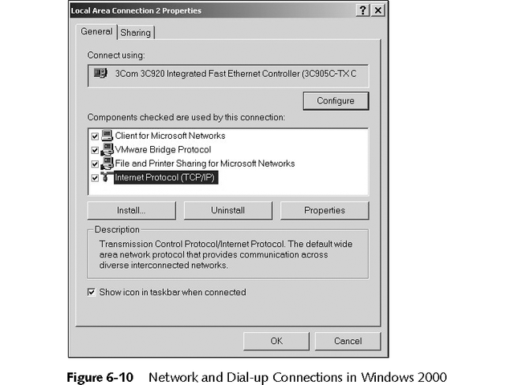
Network and Dial-up Connections

Slide 61
Putting Data on the Cable: Access Methods
Consider several factors
How computers put data on the cable
How computers ensure data reaches destination undamaged

Slide 62
Function of Access Methods
Rules specify when computers can access cable or data channel
Channel access methods assure data reaches its destination
Prevents two or more computers from sending messages that may collide on cable
Allows only one computer at a time to send data

Slide 63
Major Access Methods
Channel access is handled at Media Access Control (MAC) sublayer of Data Link layer
Five major access methods
Contention
Token passing
Demand priority
Polling
Switching

Slide 64
Contention
In early networks, contention method allowed computers to send data whenever they had data to send, resulting in frequent collisions and retransmissions
Figure 6-11 shows data collision
Two carrier access methods were developed for contention-based networks
Carrier Sense Multiple Access with Collision Detection (CSMA/CD)
Carrier Sense Multiple Access with Collision Avoidance (CSMA/CA)

Slide 65
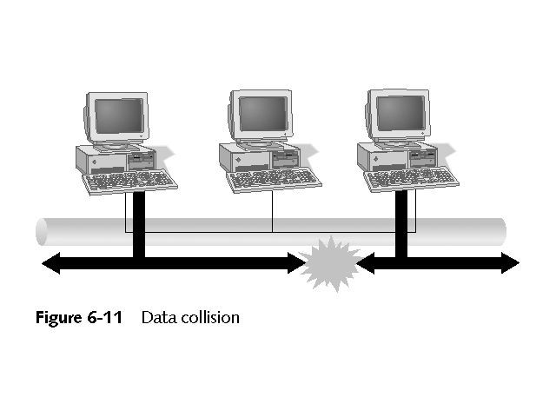
Data Collision

Slide 66
CSMA/CD
Popular access method used by Ethernet
Prevents collisions by listening to channel
If no data on line, may send message
If collision occurs, stations wait random period of time before resending data
See Figure 6-12

Slide 67
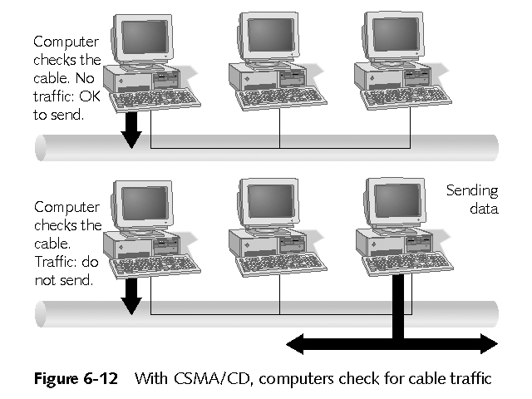
CSMA/CD

Slide 68
CSMA/CD
Limitations and disadvantages of CSMA/CD
Not effective at distances over 2500 meters
More computers on network likely to cause more collisions
Computers have unequal access to media
Computer with large amount of data can monopolize channel

Slide 69
CSMA/CA
Uses collision avoidance, rather than detection, to avoid collisions
When computer senses channel is free, it signals its intent to transmit data
Used with Apple’s LocalTalk
Advantages and disadvantages
More reliable than CSMA/CD at avoiding collisions
“Intent to transmit” packets add overhead and reduce network speed

Slide 70
Token Passing
Token passes sequentially from one computer to next
Only computer with token can send data, as seen in Figure 6-13
Advantages and disadvantages
Prevents collisions
Provides all computers equal access to media
Computer must wait for token to transmit, even if no other computer wants to transmit
Complicated process requires more expensive equipment

Slide 71
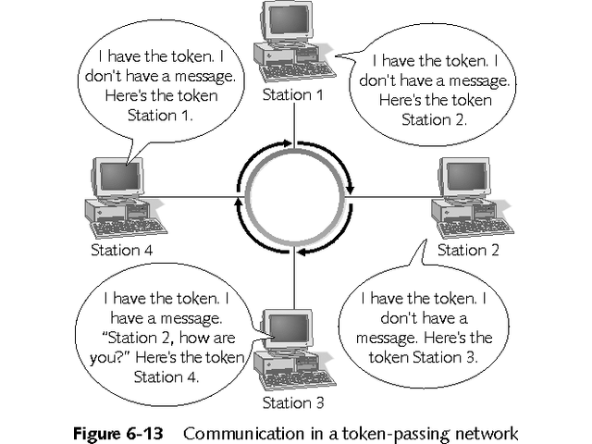
Communication in a Token-Passing Network

Slide 72
Demand Priority
Used only by 100VG-AnyLAN 100 Mbps Ethernet standard (IEEE 802.12)
Runs on star bus topology, as seen in Figure 6-14
Intelligent hubs control access to network
Computer sends hub demand signal when it wants to transmit
Advantages and disadvantages
Allows certain computers to have higher priorities
Eliminates extraneous traffic by not broadcasting packets but sending them to each computer
Price is major disadvantage

Slide 73
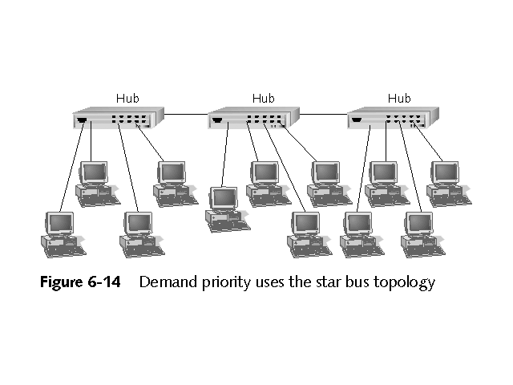
Demand Priority Uses Star Bus Topology

Slide 74
Polling
One of oldest access methods
Central controller, called primary device, asks each computer or secondary device if it has data to send, as seen in Figure 6-15
Advantages and disadvantages
Allows all computers equal access to channel
Can grant priority for some computers
Does not make efficient use of media
If primary device fails, network fails

Slide 75
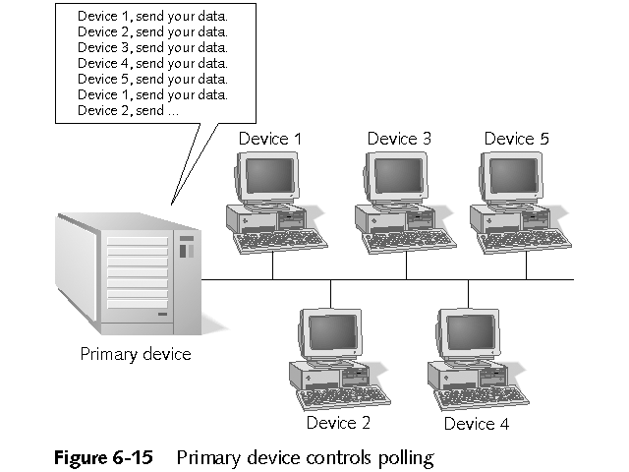
Primary Device Controls Polling

Slide 76
Switching
Switch interconnects individual nodes and controls access to media
Switching usually avoids contention and allows connections to use entire bandwidth
Other advantages include
Fairer than contention-based technology
Permits multiple simultaneous conversations
Supports centralized management
Disadvantage include
Higher cost
Failure of switch brings down network

Slide 77
Choosing an Access Method
Network topology is biggest factor in choosing access method
Ring topology usually uses token-passing
Switching can emulate all common topologies
See Tables 6-3 through 6-7 for summaries of the five access methods

Slide 78
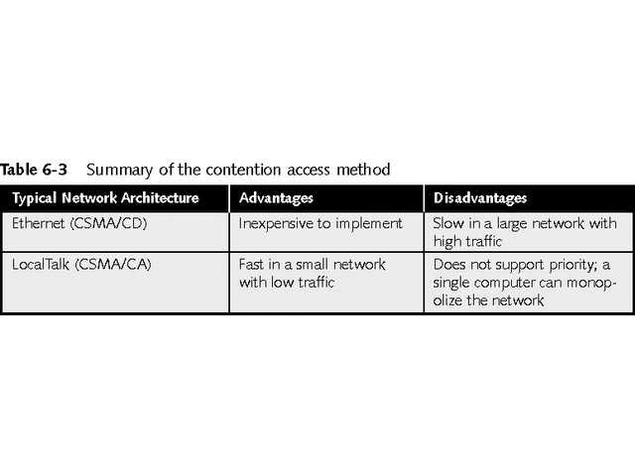
Contention Access Method

Slide 79
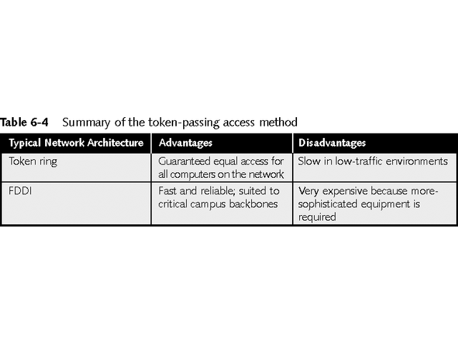
Token-Passing Access Method

Slide 80
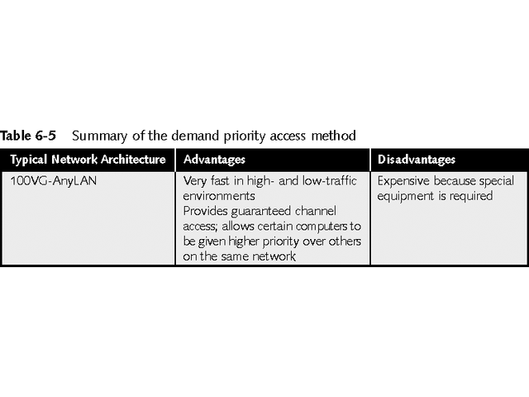
Demand Priority Access Method

Slide 81
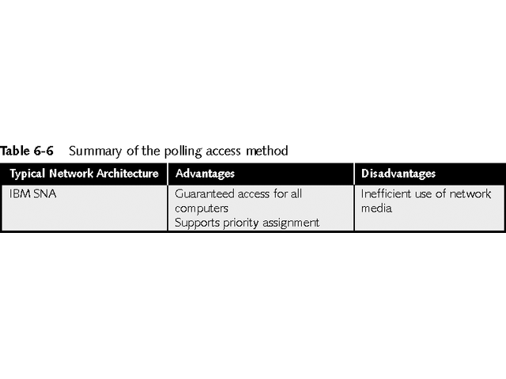
Polling Access Method

Slide 82
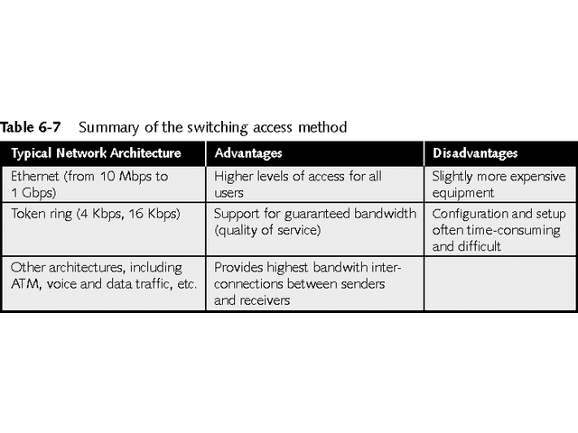
Switching Access Method

Slide 83
Chapter Summary
Data stream on a network is divided into packets to provide more reliable data delivery and ease network traffic
If errors occur during transmission, only packets with errors will be re-sent
As data travels through layers of OSI model, each layer adds its own header or trailer information to packet

Slide 84
Chapter Summary
As receiving computer processes packet, each layer strips its header or trailer information and properly re-sequences segmented message so that packet is in original form
Many protocols are available for network communications
Each protocol has strengths and weaknesses
A suite, or stack, of protocols allows a number of protocols to work cooperatively

Slide 85
Chapter Summary
Major protocol suites are TCP/IP, IPX/SPX, and NetBEUI
Each suite contains many smaller protocols, each of which has its own network function
IP addressing involves several concepts, including address classes, subnetting, supernetting, and subnet masks

Slide 86
Chapter Summary
Current method for Internet addressing is called CIDR, which uses all available addresses more efficiently
Other IP addressing concepts include:
DHCP, a method for automatic assignments and management of IP addresses
NAT, which allows companies using private IP addresses to access the Internet and use public IP addresses more efficiently

Slide 87
Chapter Summary
When a computer is ready to send data, it must be assured that data will reach destination
Perfect environment does not exist where all computers can have dedicated channel over which to send information
Rules have been established to ensure that all computers have time on the channel
Token passing and polling guaranteed time for each computer to send its data

Slide 88
Chapter Summary
Demand priority allows computer to send data after it notifies controlling hub
In contention channel access methods, computers vie for network time
They listen to network to determine whether another computer is sending data
If not, they send their data (CSMA/CD) or broadcast their intention to send data (CSM/CA)
Switching can emulate all other access methods and offers greatest total available bandwidth

